Slide 1

Health Insurance Analysis
A data driven analysis

Slide 2
Mini Project: Power BI Data Analysis Challenge!
STUDY GROUP 2
Team 6
• Diana Ofili - 2024/WTF/DS/0233 Diana.Ofili@womentechsters.org
• Wuraola Ariwodola - 2024/WTF/DS/0018 wuraolaariwodola@womentechsters.org
• Grace Ngari- 2024/WTF/DS/0068 GraceNgari@womentechsters.org
• Lilian Omolu - 2024/WTF/DS/0368 LilianOmolu@womentechsters.org

Slide 3
INTRODUCTION

Slide 4
CONTENT
Title - - - - - - - - - - - - - - - - - - - - - - - - - - - - - - - - - - - - - - - - - - - - - - - - -- - - - - - - -1
Subtitle - - - - - - - - - - - - - - - - - - - - - - - - - - - - - - - - - - - - - - - - - - - - - - - - - - - - - 2
Introduction - - - - - - - - - - - - - - - - - - - - - - - - - - - - - - - - - - - - - - - - - - - - - - - - - 3
Content - - - - - - - - - - - - - - - - - - - - - - - - - - - - - - - - - - - - - - - - -- - - - - - - - - - - -4
Visual one - - - - - - - - - - - - - - - - - - - - - - - - - - - - - - - - - - - - - - - - - - - - - -- - - - - 5
Visual Two - - - - - - - - - - - - - - - - - - - - - - - - - - - - - - - - - - - - - - - - - - - - - - - - - - 6
Visual Three - - - - - - - - - - - - - - - - - - - - - - - - - - - - - - - - - - - - - - - - - - - - - - - 7 - 8
Visual Four - - - - - - - - - - - - - - - - - - - - - - - - - - - - - - - - - - - - - - - - - - - - - - - - - - -9
Conclusion - - - - - - - - - - - - - - - - - - - - - - - - - - - - - - - - - - - - - - - - - - - - - - - - - 10

Slide 5

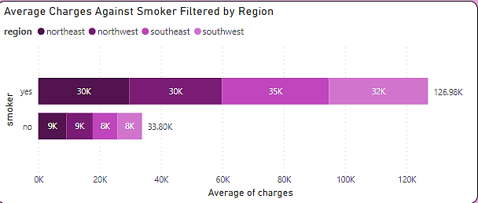
Visual one - Variables: Average Charges - Numerical values Smoker - Categorical values
Observations
Observations from the dataset revealed that smokers pay more for health insurance than non-smokers.
Even when filtered by region to check for any inconsistency or bias, the filtration still validated the initial findings

Slide 6
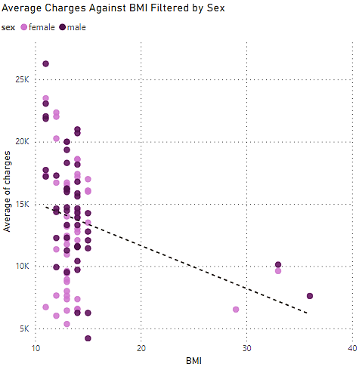

Visual Two - Variables: Average charge – numerical values BMI – categorical values Sex – categorical values
Observations
It was observed that there is no form of relationship between the average insurance charge and the BMI of its subscription holders.
The correlation between these two variables is negative even when filtered by a third variable sex(gender).

Slide 7
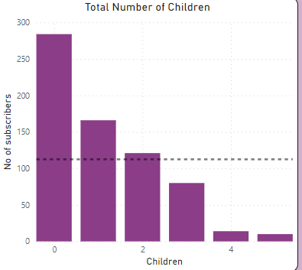
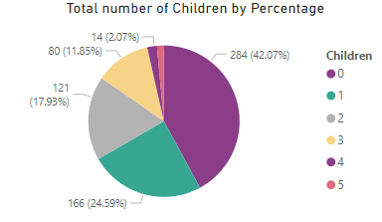
Visual Three - Variables: Average charges – numerical values Children – categorical values

Slide 8
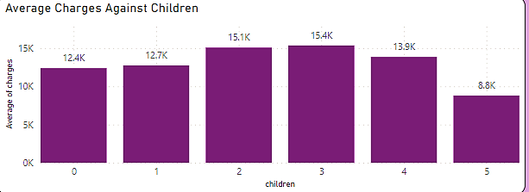
Visual Three - Variables: Average charges – numerical values Children – categorical values
Observations
Insights from the dataset shows that subscription holders with one or more kids tend to pay more than individuals with no kids.

Slide 9
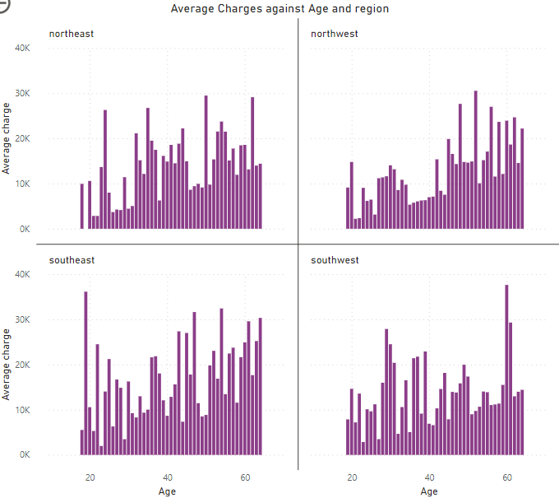
Visual Four - Variables: (Average charges – numerical values, Age – categorical values, Region – categorical values)

Slide 10
Conclusion
The analysis denoted that smokers understands that smoking is liable to cause health challenges hence the reason why smokers pay for more insurance than none smokers,
It is understood that people with kids tend to pay more bills than people with no kids, hence the reason why subscription holders with one or more kids tend to pay more than individuals with no kids.
Our group made sure to use the best charts to visualize insights and break the dataset in a way that it can be easily understood especially by non-techies.

